Slide 1
Horizontal monitoring in Bosnia & Herzegovina

Slide 2
Horizontal Monitoring
Preventive measure of the tax supervision with the aim that:
  the ITA can rely on voluntary compliance of obligations for indirect taxes,
  the ITA provides to the large taxpayer of indirect taxes a tax certainty in respect to his tax position which he possesses and reduces administrative burden in terms of tax supervision

Slide 3
Fundamental principles
The principle of voluntary fulfilment of indirect taxes obligations
The principle of reducing the administrative burden of tax supervision

Slide 4
VOLUNTARY FULFILLMENT OF INDIRECT TAXES OBLIGATIONS
TRANSPARENCY
UNDERSTANDING
ACTING IN GOOD FAITH
TRUST

Slide 5
Horizontal monitoring phases
1. Procedure for granting of applicant status
2. Procedure of an assessment of enforceability of horizontal monitoring
3. Procedure of the conclusion and application of the horizontal monitoring agreement
4. Supervision over the enforceability of the Agreement on horizontal monitoring

Slide 6

Horizontal monitoring cycle
APPLICANT STATUS
CONDUCTIVITY ASSESSMENT
AGREEMENT CONCLUSION

Slide 7
Procedure for granting applicant status
Submitting a request for an assessment of the enforceability of horizontal monitoring,
Reviewing requirements for assessing the enforceability of horizontal monitoring and
Decision on the status of the applicant.

Slide 8
Requirements for status of an applicant
* Headquarters in BiH
* No criminal offenses
* Positive audit report
* Internal control system in force
* Compliance with obligations for indirect taxes
* Is not in an appeal procedure and / or an administrative dispute against the ITA

Slide 9
Procedure of assessing the enforceability of horizontal monitoring
Continuous monitoring,
Creating a tax profile,
Assessment of the tax control framework (TCF),
The interview with the applicant,
Preparation for the horizontal monitoring agreement conclusion.

Slide 10
Continuous monitoring
Electronic exchange and data processing
Excerpt from the General Ledger (analytics with separated opening balance, current turnover and closing balance);
Review of customers and suppliers, if they are not within the Trial balance;
KUF (Book of incoming invoices);
KIF (Book of outgoing invoices);
VAT return;
Overview of the inventory of finished products, raw materials, materials and intermediate goods from material accounting books per all warehouses and per all periods;
Overview of excise goods inventory from material accounting books per all warehouses (excise taxpayers only);
Review of the status of charged, discharged and excise stamps in inventory, by serial numbers (excise taxpayers only);

Slide 11
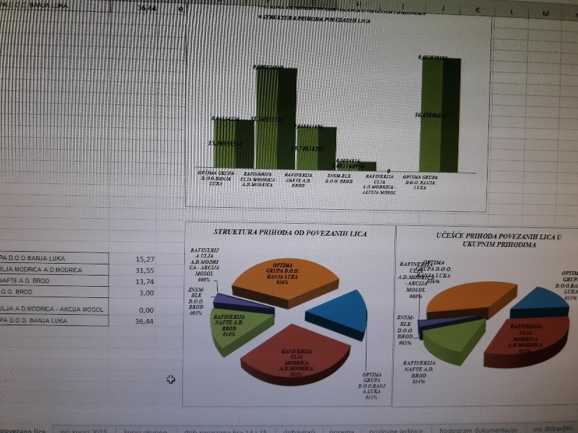
Tax profile
The applicant‘s tax profile allows to the ITA to estimate the expectation that the applicant will fulfil the obligations of indirect taxes during the validity of the horizontal monitoring agreement.

Slide 12
Assessment of the TCF
0-30
DOCUMENTATION OF TAX STRATEGY
COMPREHENSIVE APPLICATION OF THE STRATEGY
DISTRIBUTION OF RESPONSIBILITIES
DOCUMENTATION OF THE INDIRECT TAXATION MANAGEMENT
SYSTEM
TESTING
EFFICIENCY
CONTROL

Slide 13

Interview with the applicant
Objectives:
Assessment of the justification and the purposefulness of concluding horizontal monitoring agreement;
Getting to know the applicant‘s and the ITA‘s expectations in relation to further assessment of the enforceability of horizontal monitoring, as well as eliminating eventual irregularities and deficiencies identified during the implementation of phases in the procedure of assessing enforceability.

Slide 14
Completion of the assessment procedure
Successful
- Report on the assessment of the enforceability of horizontal monitoring
- Proposal for conclusion of the horizontal monitoring agreement
Unsuccessful
- Possibility to eliminate deficiencies and submit a new request for assessment of enforceability

Slide 15
Conclusion and application of the agreement
Contractual obligations of the taxpayer
Contractual obligations of the ITA
Cancellation and termination of the Agreement

Slide 16
Supervision over the application of the Agreement
INTERNAL CONTROL OF THE TAXPAYER
INDIRECT TAXATION MANAGEMENT
SYSTEM
ASSESSMENT OF THE AGREEMENT

Slide 17
Number of agreements
40 agreements until the end of year 2020
RC Sarajevo – 14
RC Banja Luka – 10
RC Tuzla – 10
RC Mostar - 6

Slide 18
Thank you for your attention!
Dejan Radić
dejan.radic@uino.gov.ba

