Slide 1
Cross-border Remote Work -
Eliminating Tax Repercussions
International Tax Law and Policy Research Network /
Belgrade 6 October 2022
Albert RAEDLER DG TAXUD

Slide 2

Mobility of Workers – Introduction
Situation Post-Covid:
Remote working, teleworking and cross-border teleworking are likely to stay
Commission addresses the following questions from a tax point of view:
  How did the pandemic affect frontier workers in particular with regard to cross-border teleworking?
  Since teleworking will continue to be widespread used after the pandemic; are the tax rules in place appropriate and sufficient?
  If not, what could be alternative solutions ?
Notes:
Definitions according to Annual Report on Labour Mobility
Cross-border worker: are defined as EU or EFTA citizens who live in one EU or EFTA country and work in another, either as employees or self-employed. Cross-border workers therefore move across borders more or less regularly. Cross-border workers may include the legally defined groups of seasonal and frontier workers and may also include some posted workers (Regulation 883/2004).
Mobile worker: Active EU citizens who reside in a Member State or EFTA country other than their country of citizenship.
Frontier workers are defined as cross-border workers who return to their country of residence ‘as a rule daily or at least once a week’, according to Regulation (EC) No 883/2004 (Article 1(f)).
Posted worker: Posted workers for the purpose of this report includes persons covered under Articles 12 and 13 of Regulation 883/2004 on the coordination of social security systems. It includes: persons who are employed by an employer that normally carries out its activities in a Member State and who are posted by that employer to another Member State to perform work on its behalf; persons who normally pursue an activity as a self-employed person in a Member State who go to pursue a similar activity in another Member State; and such persons who pursue an activity as an employed/self-employed person in two or more Member States.
Statistics: for DE: IAB – Institut für Arbeitsmarkt- und Berufsforschung Kurzbericht Nr. 9/2020.
For LU: IBA-OIE: Observatoire Interregionale du Marché de l’Emploi, 12. Bericht, Januar 2021.

Slide 3
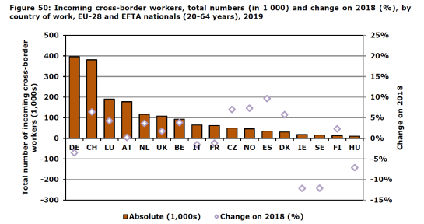
Statistics - Incoming Cross-Border Workers
Notes:
Source: Annual Report of Labour Mobility 2020.
Germany: many persons from PL, AT, FR, BE, NL and DK
AT: from CZ, SK and HU
LU: from BE, DE, FR
CH: from IT, FR, DE and AT

Slide 4
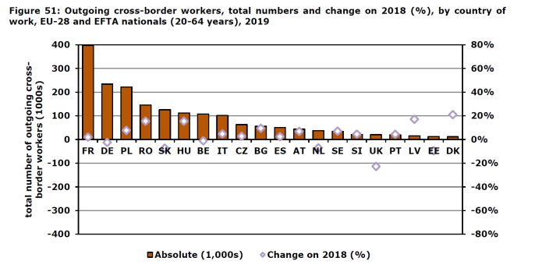
Statistics - Outgoing Cross-Border Workers
Notes:
Source: Annual Report of Labour Mobility 2020.
FR commute mainly to LU and CH, but also to DE.
DE commute to LU, CH some to BE, NL and AT
PL mainly to DE

Slide 5

Cross-Border Workers – Who and Where
Mainly border regions with hotspots, as for example:
  Grande Region BE-DE-FR-LU
  German border regions with PL, CZ, AT, FR, LU, BE, NL and DK
  Austrian border regions with CZ, SK and HU
  Greater Copenhagen DK-SE
  Estonia and Helsinki area
  Also: Switzerland with cross-border workers from mainly IT, FR, DE and AT
Exact number of cross-border teleworkers difficult to determine
Notes:
Data: we have numbers of the cross-border workers. However, there are no numbers on how many of these cross-border workers actually telework.
Many cross-border workers from Eastern Member States
Less likely of a frequent return to home
Less likely of regular cross-border teleworker (i.e. truck driver, care of elder people)

Slide 6
Principles of Taxation and Consequences
The Principle: according to Art. 15 OECD-MTC: already the first day in home office results in an pro-rata apportionment of income between source state and state of residence !
The Consequences:
…for the employer | … for the employee | … for the tax administrations
Apportionment of income in two jurisdictions Levying of wage tax as withholding tax in state of activity | Additional compliance obligations (need to declare income in 2 MS) Certain thresholds may no longer be fulfilled (Schumacker-criteria) Possible impact on overall income depending on difference in taxation in source and resident state | Apportionment results in assessing taxpayer in both states on largely the same issues (days spent in home office, auditing of wage tax requirements, disputes with taxpayer)
Notes:
Difficult provision, all 3 negative requirements need to be fulfilled. It is easier, to reformulate the provision as positive requirement, only 1 is needed.
Taxing right with the state of activity:
The employee is present in the source state for more than 183 days, or
the remuneration is paid by, or on behalf, of an employer who is resident in the state of source, or
the remuneration is borne by a permanent establishment, which the employer has in the other state
Taxing right with state of residence:
The employee is present in the state of source not more than 183 days, and
the remuneration is paid by, or on behalf of, an employer who is not resident in the state of source, and
the remuneration is not borne by a permanent establishment which the employer has in the state of source.

Slide 7
Cross-Border Teleworking – Taxing Rights
Share of Home office of total worktime | Taxation | Social Security Contributions
100 % in work state | Source state | Source state
4 days in work state, 1 day per week home office = 80 / 20 % | Source state / state of residence | Source state
1 day per week work state, 4 days home office = 20 / 80 % | Source state / state of residence | State of residence
100 % home office | State of residence | State of residence
Notes:
The benchmark would be to have alignment of income tax and social security system, preferably in state of residence.
only 1 tax declaration as no need in state of source.
Alignment of income tax and social security would be desirable because the lack of coordination could lead in cross-border situations to an obstacle to the free movement. In purely domestic situations, the levying of social security contributions and of income taxes are coordinated and consistent. In cross-border situations, if income taxes and social security contributions are levied by different Member State, the different level of income taxes and social security contributions as well as different ways of financing of social security can lead to significant inconsistencies. This lack of coordination causes problems for cross-border workers and retired cross-border workers alike. As a result, individuals who use or previously used the right to free movement may receive benefits, suffer penalties or even undergo unequal treatment. Lack of coordination between taxation and social security schemes often has undesirable consequences and results in calculating behavior by cross-border workers and employers.

Slide 8
Feedback of Public on Apportionment
Feedback from the public on apportionment:
Citizens: avoid to be subject to apportionment and thus 2 tax declarations practically at any price, instead :
  Commute long hours, taking into account stress, pollution, fatigue etc.
Companies: feedback that individual companies prohibited cross-border teleworking due to legal risks concerning labour law, social security law and tax law.
But: the tax repercussions represent obstacles to the free movement, and are as such not per-se contrary to the free movements.

Slide 9
Teleworking in normal times - Derogations
De-minimis-thresholds agreed upon between certain Member States in DTCs
a certain pre-defined number of days of absence from usual place of activity does not lead to an apportionment
The number of days agreed range from 19 days to 34 days per year
Specific Cross-Border Commuter Provisions
if certain requirements are fulfilled, in particular both place of activity and permanent home in border zone, then the state of residence maintains the taxing right
Only few bilateral situations provide for such specific cross-border commuter provisions
Temporary Crisis Measures:
Mitigation of tax repercussions during Covid Crisis due to Temporary Memoranda of Understanding: no apportionment during crisis, but limited until 30 June 2022 !
Notes:
De-minimis-Thresholds (“Bagatellgrenzen”) in DTC:
DTC Germany – Luxembourg: the income needs to be apportioned between Luxembourg and Germany in the case where the employee does not work every day at the normal place of activity. However, according to the memorandum of understanding, there is a de-minimis-limit of max 19 days/year – if this limit is not exceeded, the employee may work from places other than the usual place of activity, for example missions, trainings or teleworking.
DTC France – Luxembourg: a de-minimis limit of maximum 34 days/year (increased from 29 days as of 1/1/2022).
DTC Belgium – Luxembourg: a de-minimis limit of maximum 34 days/year (increased from 24 days as of 1/1/2022).
Specific Cross-Border Commuter Provisions:
DTC Germany – France
Persons living and working in the borderzone are only subject to taxation in the residence state. The specific cross-border commuter provision provides for a de-minimis-rule of max. 45 days/year without being present at the usual place of activity. However, teleworking is considered as an activity which has been exercised in the border zone and therefore is not taken into account for the determination of the 45 days threshold. Employees in the German-French border zone therefore do not have any tax repercussions from teleworking.
DTC Germany - Austria
The specific cross-border commuter provision in the German-Austrian DTC provide for taxation in the state of residence if both the place of activity and place of residence are within the border zone and the employee returns every day to his family home. A 2019 memorandum of understanding provides for a de-minimis-limit of max. 45 days of absence/year; teleworking was explicitly taken into account for the calculation of the 45-day-threshold. However, a recent memorandum of understanding of 14 December 2021 provides that teleworking days are deemed to be days spent at the usual place of activity.
DTC Austria – Italy: living and working in the borderzone.

Slide 10
Cross-border Teleworking: Possible Actions
1. Setting a de-minimis limit
  Cross-border teleworking without tax repercussions within set limits; avoidance of apportionment of income
  Concept exists in practice. Number of days range from 19 – 34 days per year, but: number of days insufficient for 1 day/week cross-border teleworking
2. Setting a de-minimis limit aligned with social security threshold
  Social security provisions provide for a change of applicable social security system in case of 25 % or more home office, i.e. ≈ 220 x 25 % = 55 days
  Solution would allow for 1 day per week cross-border teleworking on a regular basis
3. One-stop-Shops with possibly financial compensation for offsetting imbalances
  Cross-border worker only deals with one tax administration – ideally the residence state
  In a perfect world equal number of outbound and inbound – in practice often imbalances - which could be set-off by financial compensations between Member States.
Notes:
DTC Germany – Luxembourg: a de-minimis limit of maximum 19 days/year.
DTC France – Luxembourg: a de-minimis limit of maximum 34 days/year (increased from 29 days as of 1/1/2022).
DTC Belgium – Luxembourg: a de-minimis limit of maximum 34 days/year (increased from 24 days as of 1/1/2022).

Slide 11
Initiatives of other Institutions
Other Initiatives – inter alia – :
BENELUX Interparliamentary Assembly: Recommendation 920/2 of 23 March 2021 for 48 days/year cross-border teleworking
Assemblée Nationale FR: Resolution Européenne, n°819 of 9 March 2022 for 96 days/year cross-border teleworking
Petition to the German Bundestag for an alignment of cross-border teleworking to Social Security Threshold of appr. 55 days/year.
European Economic and Social Committee - EESC: Own initiative Opinion on “Taxation of cross-border teleworkers and their employers” of 13 July 2022, ECO/585

Slide 12
Cross-border Teleworking: Commission Action
Commission has addressed the issue repeatedly with Member States:
Commission Working Party IV – Direct Tax in September 2021
Platform of Good Governance in September 2021
Informally with Heads of Tax Administration
Annual Report of Taxation 2022
Repeatedly: Written Questions by MEPs
Options for Commission Action: difficult scenario
Issue dealt with by Member States in bilateral Conventions – in general no appetite by Member States for Commission initiatives in this area
Proposal of a Directive? Politically difficult, as subject to unanimity
Recommendation ? Possibly
Notes:
Example: Taxation of pensioners according to the German-French DTC from 2015.
Ideally, the one stop shop would be located in the country in charge for social security.

Slide 13
THANK YOU FOR YOUR ATTENTION !

Slide 14








Keep in touch
ec.europa.eu/taxation_customs/
@EU_Taxud
ec.europa.eu/
@EU_Commission
europeancommission
@EuropeanCommission
@EuropeanCommission
EUTube
European Commission
EU Spotify
Notes:
Delete/update as appropriate

Slide 15

Thank you
© European Union 2020
Unless otherwise noted the reuse of this presentation is authorised under the CC BY 4.0 license. For any use or reproduction of elements that are not owned by the EU, permission may need to be sought directly from the respective right holders.
Slide xx: element concerned, source: e.g. Fotolia.com; Slide xx: element concerned, source: e.g. iStock.com
Notes:
Update/add/delete parts of the copy right notice where appropriate.
More information: https://myintracomm.ec.europa.eu/corp/intellectual-property/Documents/2019_Reuse-guidelines%28CC-BY%29.pdf

