Slide 1
TAX MORALity IN SERBIAN BUSINESS SECTOR- AN EMPIRICAL INVESTIGATION
Branko Radulovic
Faculty of Law
University of Belgrade

Slide 2
introduction
Research question
  What drives tax morality in Serbian business sector?
  Tax morale (morality) is usually defined as nonpecuniary or intrinsic motivation for tax compliance (Luttmer & Singhal, 2014, p. 150).
Empirical literature usually ﬁnd that the real level of tax evasion is signiﬁcantly lower than forecasts made using the rational choice model
Significance
  Tax compliance and shadow economy in Serbia have attracted increasing attention from policymakers and academics (Ranđelović, 2017).
  Tax morale is an important determinant of participation in shadow economy (Krstić & Radulović, 2015, 2017)
  Most of the literature on tax morale has focused on individuals, not on firms – only a handful of articles on businesses’ tax morale
  Better understanding of tax morale may contribute to the reduction of tax evasion by suggesting alternative mechanisms of enforcement

Slide 3
Approach
Three alternative approaches
  Real Tax Compliance Data
  Surveys
  Experiments (BE)
We exploit novel data set for more than 1000 surveyed registered businesses (firms and entrepreneurs - sole proprietors) collected in 2017
Most relevant literature
Mickiewicz, T., Rebmann, A. & Sauka, A. J Bus Ethics (2017)

Slide 4
APPROACH
Tax compliance/
Informality
Tax deterrence
Tax Morality
Determinants ...
Determinant 3
Determinant 1
Determinant 1

Slide 5
DEPENDANT VARIABLE
What is your attitude to the justification of informal business activities?
The index has been represented in the 5 point Likert scale.
The lower the index value, the higher is the tax morale (1 means not at all acceptable and 5 means completely acceptable).
  Reduced to 4 (merged few observations stating informality is completly acceptable)
We believe that this question captures tax morale rather well
  Informal business is defined as actions taken by individuals and firms to reduce their legally due tax obligations, by underreporting incomes or sales to evade consumption and proﬁt taxes and “envelope wages” to evade payroll tax and social security contributions

Slide 6
Determinants (1)
To examine determinants that influence tax morale of businesses in Serbia we use several groups of factors.
Businesses’ perception of the tax authority
  Hypothesis 1A: Businesses who negatively perceive tax inspection will judge underreporting to be less unacceptable (unethical) than taxpayers who have favourable view about tax authorities.
  Hypothesis 1B: Businesses who believe that the government tolerates tax evasion have a lower tax morale.
Businesses’ perception on how widespread evasion behaviour is in a society or in a particular sector
  Hypothesis 2A: Businesses who notice (believe) that many other registered businesses evade taxes have a lower tax morale.
  Hypothesis 2B: Businesses who notice that many businesses are not registered have a lower tax morale.

Slide 7
Determinants (2)
Businesses’ perception of the fairness of the tax system
  Hypothesis 3A: Businesses who perceive tax spending as inefficient and inequitable have a lower tax morale.
  Hypothesis 3B: Businesses who believe that the tax burden is high have a lower tax morale.
Complexity may result in (un)intentional non-compliance.
  Hypothesis 4: Businesses who state that tax laws and rules are complicated have a lower tax morale.

Slide 8
Determinants (3)
Businesses’ trust in the government (public officials) affects their willingness to comply.
  Hypothesis 5: Businesses with low trust in governments’ intention to curb tax evasion will judge informal activities to be less unethical than taxpayers with high trust in government.
Deterrence factors may influence the tax morale i.e. tax morale may be affected by a self-serving bias whereby people adjust their norms/attitudes according to their self-interest.
  Hypothesis 6A: Business owner/managers who perceive a greater likelihood of being caught evading tax are likely to have a higher tax morale.
  Hypothesis 6B:Business owner/managers who perceive tax evaders to be more severely punished when caught are likely to have higher tax morale.
  Hypothesis 6C: Business owner/managers who perceive tax evaders often use bribes to evade punishment are likely to have lower tax morale

Slide 9
OTHER CONTROL VARIABLES
Entrepreneurs vs Companies
Lossmakers vs profitable businesses
Foreign and mixed vs Domesic ownerhsip
VAT and nonVAT taxpayers
Regions (other parts of Serbia vs Belgrade)
Sectors
Owner vs Manager

Slide 10
RESULTS
Ordered probit and logit models
„More likely to be in a higher category“ interpretation
Intercepts are significantly different from one another
No issues with multicollinearity

Slide 11
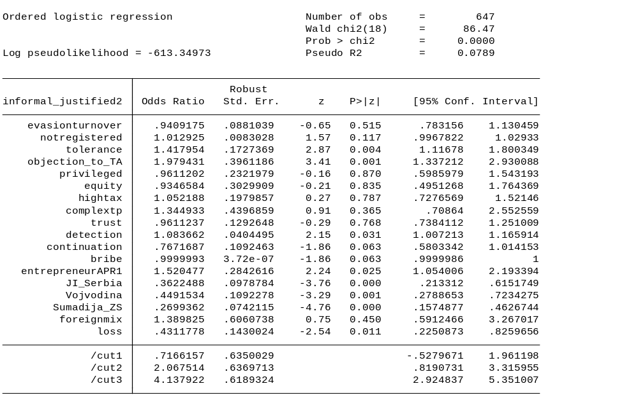

Slide 12
Results
Businesses’ perception of the tax authority quite important
Deterrence factors both statistically and substantially significantly influence the tax morale i.e. tax morale may be affected by a self-serving bias whereby people adjust their norms/attitudes according to their self-interest.
Businesses’ perception on how widespread evasion behaviour is in a society or in a particular sector is impotant is several specifications
Tax burden important in several specifications

Slide 13
Results
  More likely to be in a higher category
    Entrepreneurs
    Belgrade!!!!
    Profitmaking companies
    Transportation Sector
    Foreign?
Limitation of results – expected signs but not statistically significant
  Not tailor made – missing political preferences, education, sex and several other control variables
  Not perfectuly capturing complexity

Slide 14
Conslusion
TA relationship with Taxpayers rather important – those who object to TAs approach much more likely to justify informality
  Improving trust between TA and owner/managers
  Inconsistent or inadequate application of tax related rules, time consuming procedures, ...
  General tolerance vs privileged businesses
Businesses adjusted their norms/attitudes according to their self-interest
Forthcoming campaigns should focus on Belgrade, entrepreneurs, profitmaking companies, specific sectors

