Slide 1

MEASURES AIMED AT COMBATING
VAT FRAUD
Dr hab. Krzysztof Lasiński-Sulecki
Professor at Nicolaus Copernicus University in Toruń, Poland
Head of the Centre of Fiscal Studies

Slide 2
VAT FRAUD
Types of VAT fraud:
underreported supplies
inflated refund claims
domestic sales disguised as exports or intra-Community supplies
fictitious traders
missing traders
carousel fraud

Slide 3
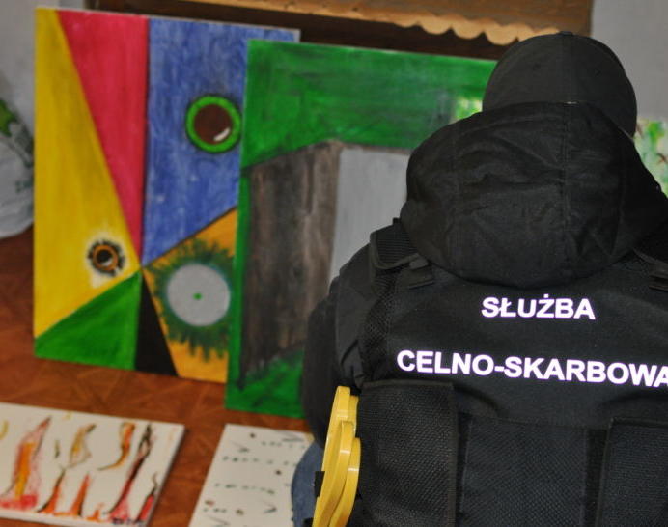
VAT FRAUD
How much would you pay for these pictures?
Source: TVN

Slide 4
VAT FRAUD
MEASURES AIMED AT COMBATING VAT FRAUD
(nearly) purely legal: legal + technical:
reverse charge electronic invoicing
joint and several liability (+ database)
split payment registration
big data
monitoring

Slide 5
VAT FRAUD
REVERSE CHARGE
VP1: No VAT connected with this supply VP2: liable for VAT on this supply
Price: EUR 100 EUR 100 + VAT (followed by: - VAT)
New problem: proper identification of purchasers
Technical measures: restricted payment methods + quick verification of returns
VATABLE PERSON NO. 1
VATABLE PERSON NO. 2
supply

Slide 6
VAT FRAUD
JOINTS AND SEVERAL LIABILITY
VAT: 100 + VAT VAT deductible
VP2 can be held liable for
VP2’s output VAT
No major technical issues
VATABLE PERSON NO. 1
VATABLE PERSON NO. 2
supply

Slide 7
VAT FRAUD
SPLIT PAYMENT
VAT
PRICE (VAT EXCL.) Technical issues: banks
SUPPLIER
BUYER
supply
SUPPLIER’S VAT ACCOUNT
SUPPLIER’S STANDARD ACCOUNT

Slide 8
VAT FRAUD
REGISTRATION
database of registered entities:
up-to-date
easily accessible

Slide 9
VAT FRAUD
REPORTING
monthly reporting (or even real time reporting)
PL: selected entrepreneurs can file quarterly returns (earlier: all taxpayers could)
PL: obligation to file returns to be abolished
electronic format
e-receipts

Slide 10
VAT FRAUD
BIG DATA
daily analysis of all bank transfers
risk profiling - algorithm aimed at identifying transfers connected with fraudulent activities
bank accounts blocked for up to 72 hours / 3 months

Slide 11
VAT FRAUD
MONITORING OF TRANSPORT
PL: SENT
fuel, denatured alcohol, dried tobacco
dispatcher – carrier – receiver
upon dispatcher’s request SENT number is generated along with 3 keys (for entities involved)

Slide 12
Thank you
Krzysztof Lasiński-Sulecki
kls@umk.pl
+48 608 532 260

