Slide 1


The Implementation of the Standard Audit File for Tax (SAF-T) for VAT Reporting in Poland
Dr. Małgorzata Sęk
Centre of Tax Documentation and Studies & Tax Law Department
Faculty of Law and Administration, University of Lodz
Belgrade, 28.09.2018

Slide 2


Terminology
 | SAF-T (Standard Audit File for Tax) is a computer file that allows the easy export of a predefined set of accounting data in a commonly-readable format, especially for the purposes of a tax audit. SAF-T v1.0 (OECD, 2005) SAF-T v2.0 (OECD, 2010)
 | JPK (Jednolity Plik Kontrolny = Unified Control File) is the Polish equivalent of SAF-T, based on SAF-T v2.0.

Slide 3
JPK components
Every month:
JPK_VAT Ewidencje zakupu i sprzedaży VAT (VAT Purchase and Sale Registry) = VAT Uniform Control File
On demand only
(tax proceedings, verification activities, tax audit, tax and customs audit):
JPK_FA Faktury VAT (VAT sales Invoices)
JPK_KR Księgi Rachunkowe (Accounting Books) or
JPK_PKPIR Podatkowa księga przychodów i rozchodów (Tax Revenue and Expense Ledger) or
JPK_EWP Ewidencja przychodów (Revenue Ledger)
JPK_WB Wyciągi bankowe (Bank Statements)
JPK_MAG Magazyn (Warehouse Data)

Slide 4
JPK implementation stages
 | JPK_VAT monthly | other JPK on demand
large entrepreneurs avarage annual employment ≥ 250 or annual net turnover > EUR 50 mln and cumulatively annual balance sheet assets over EUR 43 mln | 1.07.2016 | 1.07.2016
small and medium entrepreneurs employment < 250 and turnover ≤ EUR 50 mln or alternatively balance sheet ≤ EUR 43 mln | 1.01.2017 | 1.07.2018
micro entrepreneurs employment < 10 and turnover or alternatively balance sheet ≤ EUR 2 mln | 1.01.2018 | 1.07.2018
from 200 thousand to
1.6 mln a month !
Notes:
Monthly: all VAT taxable persons who are oblidged to keep the VAT purchase and sales registry. It is mandatory to keep this registry in eletronic form.
On demand: only those taxable persons who keep tax books in an eletronic form.

Slide 5
JPK_VAT
VAT Purchase and Sale Registry
data necessary for the proper preparation of the tax return and recapitulative statement , i.a. data necessary to determine:
the subject and basis of taxation,
the amount of output tax,
corrections of output tax,
the amount of input tax reducing the amount of output tax,
corrections of input tax,
the amount of tax to be paid to the tax office or to be refunded,
as well as other data used to identify individual transactions, including the number by which the counterparty is identified for VAT purposes
Records are kept in electronic form using computer programs.

Slide 6
JPK difficulties
differentation of implementation dates – unclear definitions of taxpayer categories
costs of adapting or implementing IT systems
late publication of detailed technical standards and late availability of dedicated software provided by TA
lack of clear guidance for non-standard situations (technical & substantive)
costs of inputing additional data (personnel or technology, e.g. OCR)
costs of cross-checking data
qualified electronic signature (commerial) or „trusted profile” needed
Internet access needed (however JPK on demand can be provided with the use of a pen drive, a memory card, a CD/DVD; not by e-mail!)
alarming offers of software, compliance support, etc.
false e-mails infected with viruses, or intended to extort data etc.

Slide 7
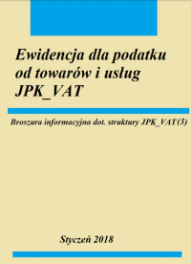
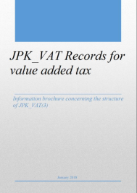
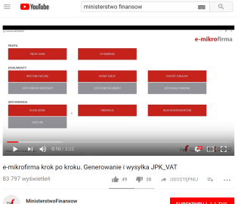
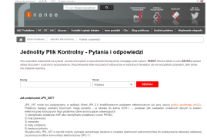
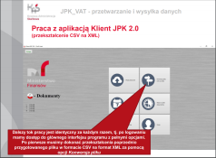
JPK facilities
information campains
step-by-step brochures and instructional videos
help desk and call-centre
dedicated software provided by the TA:
Klient JPK.2 application (all JPK components, coversion of JPK_VAT CSV to XML; user manual 32 pages)
E-mikrofirma application (JPK-VAT, JPK-FA, sale and purchase invoices; user manual 92 pages)
commercial accounting software or online applications

Slide 8
JPK effects
TA and TS perspective
faster, better-targeted, more effective tax audits due to access to vast data collection and use of analythical tools
without visits to tax offices and without being visited on site by tax inspectors (less costs, no distrubance to daily operations)
preventive effect: elimination of fraudulent entities (less risk to be involved, less unfair competition)
more VAT revenue
less VAT audits
better audit results

Slide 9
JPK effects
TA perspective:
faciliates cross checking of transactional data (output of the supplier and input of the customer)
faciliates cross checking of types of taxes (turnover and revenue, input VAT and tax expenses)
faciliates use of advance risk analysis tools
TP perspective:
after implementation period, less burdensome automated reporting
incentive to use e-invoicing and e-keeping of tax records, OCR technology, etc. to take full advantage of automation (but return to paper records among the smallest TP has been reported → on demand JKP, including JPK-FA only applicable to „entities keeping tax records using computer programs”)

Slide 10
JPK way forward
new JPK_VDEK to replace VAT returns
date and details yet unknown
single file replacing JPK_VAT and VAT return (e-return already mandatory!)
JPK-VAT contents + additional elements reflecting the contents of a VAT return (VAT to be paid, VAT to be refunded, VAT to be carried forward, etc.)
JPK Financial Statements (1.10.2018)
Central Repository of Invoices (?)
Central Repository of Cash Registers Receipts (2019?) (continuous, automated and direct data transmission)
dates and details yet unknown

Slide 11
Stages of digitalization of VAT reporting and auditing
real
time
periodical SAF-T
SAF-T on request
paper filing of VAT returns
country specific
standardized e-formats
e-filing of VAT returns
Notes:
Matching of data with bank statements, financial reports, etc.
Ultimate level if real time reporting and cross matchning with other data.

Slide 12
JPK and worldwide trends
Poland among leading European coutries implementing SAF-T (e.g. Austria, France, Lithuania, Luxembourg, Portugal (periodical!))
SAF-T introduced, but not yet mandatory (e.g. Norway 2020)
country specific file standards (e.g. Belgium, the Netherlands, Sweden)
detailed periodical VAT reports with transactional data, sometimes depending on tresholds, types of contractors, etc. (e.g. Czech Republic, Estonia, Italy, Latvia, Romania, Slovakia)
Real time or near-real-time reporting, e.g. invoice reporting or authorization
Hungary (invoice reporting real time over HUF 100.00 = EUR 322)
Spain (invoice reporting within 4 days)
Greece (invoice reporting real time 2019)
Italy (e-invoicing through TA system 2019)
non-European: Argentina, Brazil, China, Mexico, etc.

Slide 13
Thank you for your attention!

