Slide 1
Explaining Shadow Economy and Tax Evasion: from Rational Choice to Tax Morale
Saša Ranđelović
Associate professor & Vice dean for international relations and finance
University of Belgrade – Faculty of Economics
CEE IFA Conference, University of Belgrade – Faculty of Law
Belgrade, 28 September 2018

Slide 2
Outline
Shadow economy and tax evasion: basic concepts
Tax evasion modelling: rational choice under uncertainty
Behavioral models and tax morale
Overview of empirical results on shadow economy/tax evasion and tax morale
Conclusions and policy recommendations

Slide 3
Shadow Economy and Tax Evasion: Basic Concepts
Shadow economy:
  Legal economic activities which are carried out informally, i.e. not officially recorded
    Synonims: grey economy, informal economy
  Black economy – ilegal economic activities
  Unmeasured economy: the shadow economy + imputed transactions
Motives: tax evasion, non-compliance with regulatory standards, flexibility….
Tax evasion is the illegal failure to pay tax
  Tax avoidance is the reorganization of economic activity to lower tax payment
    e.g. use of electronic cigarettes instead of the tobacco cigarettes
  No clear borderline
Difference between the shadow economy and tax evasion

Slide 4
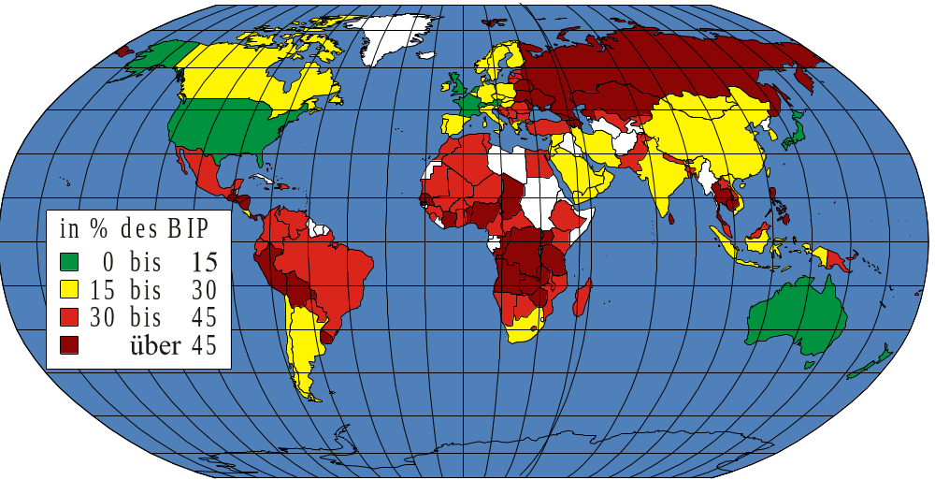
Shadow Economy Worldwide (% GDP)
in % of GDP
0 to 15
15 to 30
30 to 45
over 45
Source: Schneider, Buehn and Montenegro (2010)

Slide 5
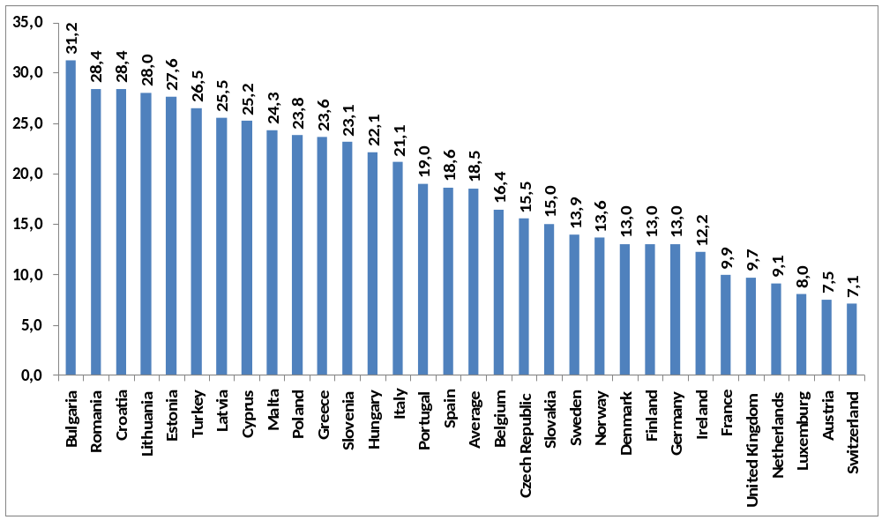
Shadow Economy in the OECD
Size of the shadow economy (in % of GDP)

Slide 6
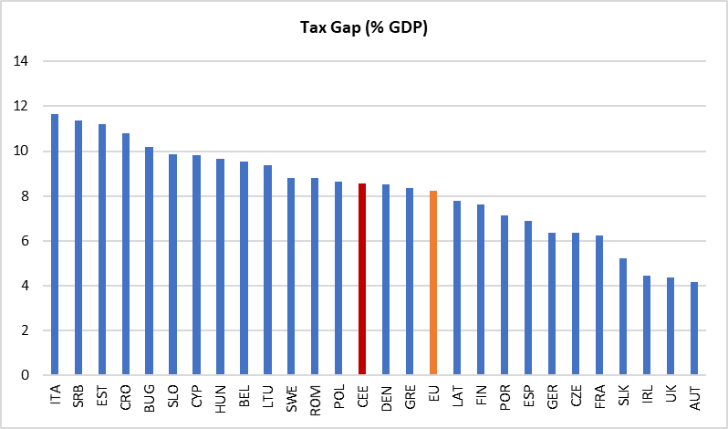
Tax Gap in Europe

Slide 7
Why Do We Care About
Shadow Economy and Tax Evasion?
Decline of tax revenues undermines provision of public goods and services
  Education, healthcare, rule of law, infrastructure, etc.
Violation of the level playing field – fair competition
Increase in income/wealth inequality undermines social stability
Non-declared income/revenues more likely to be used to finance illegal activities (e.g. terrorism)
Informal business activities violate some of the basic human rights (e.g. access to healthcare or education)
…

Slide 8
Tax Evasion Modelling:
Rational Choice under Uncertainty
Tax evasion decision – rational choice under uncertainty
  concept borrowed from the theory of crime (Becker, 1968)
If a taxpayer declares less than their true income (or overstates deductions):
  Two outcomes: not to be detected or to be detected
    When they are caught a punishment is inflicted (fine or imprisonment)
Taxpayer decides on tax evasion based on the benefits (unpaid tax) and costs (expected fine = penalty rate x probabilty of detection)
  Allingham and Sandmo (1972)
A taxpayer tends to balance these gains and losses taking into account the chance of being caught and the amount of fine

Slide 9
Tax Evasion Modelling:
Rational Choice under Uncertainty
Key variables:
  Y – true income; X – reported income;
  t – tax rate; F – fine (if caught); P – probability of getting caught;
Three possible outcomes:
  Full reporting: no evasion
  Y^{r} = Y – tY
  Underreporting & not getting caught Underreporting & getting caught
  Y^{nc} = Y – tX Y^{c} = [1 - t]Y - Ft[Y - X]
Marginal benefits of evasion: MB= t[Y - X]
Marginal costs of evasion: MC= pFt[Y - X]

Slide 10
Tax Evasion:
Rational Choice under Uncertainty
MC = p * marginal
penalty
MC = p * marginal
penalty
$
$
MB = t
MB = t
R*
(EUR of
underreporting)
R* = 0
(EUR of underreporting)

Slide 11
Main Determinants of Tax Evasion:
Rational Choice under Uncertainty
Model of rational choice under uncertainty suggest 4 main determinants:
  Income levels: effects depend on risk aversion
  Tax rates: ambiguous effects
  Probability of detection: negative effects
  Fines: negative effects
Empirical models based on the rational choice explain less than 2/3 of the actual size of tax evasion
  Other (non-financial) factors matter too

Slide 12
Relevance of tax morale – empirical check
Factors influencing the shadow economy | Influence on the shadow economy (in %)
 | Average values of 12 studies - with tax morale
(1) Tax and Social Security Contribution Burden | 35-38
(2) Quality of State Institutions | 10-12
(3) Transfers | 5-7
(4) Specific Labour Market Regulations | 7-9
(5) Public Sector Services | 5-7
Influence of all Factors | 62-65 %
Source: Schneider (2007)

Slide 13
Behavioural Models
Behavioural models – extension of neoclassical of models: people tend to pay taxes not only based on the cost-benefit optimization
Two groups of behavioural models:
  Models based on the expected utility: ambiguities in terms of p
  Models based on the social effects: theoretical foundations of the tax moral – social and cultural norms matter

Slide 14
Tax Morale
Intrinsic values may shape tax compliance behaviour
Tax morale: set of intrinsic, non-monetary motives to pay taxes, which are not encompassed by the expected utiltiy models
  Schmolders (1960)
Empirical evaluation:
  Tax morale explains 20-30% of variation of shadow economy across the countries (Togler and Schneider, 2009)
  Church tax in Germany not enforced by the Tax Administration, but still evasion is below 100% (Dwenger et al, 2014)
Measurement of tax morale
  European Values Survey or World Values Survey („Tax evasion is never justified“ – Do you agree?)

Slide 15
Tax Morale in CEE

Slide 16
Relevance of tax morale – empirical check
Factors influencing the shadow economy | Influence on the shadow economy (in %)
 | Average values of 12 studies - with tax morale
(1) Tax and Social Security Contribution Burden | 35-38
(2) Quality of State Institutions | 10-12
(3) Transfers | 5-7
(4) Specific Labour Market Regulations | 7-9
(5) Public Sector Services | 5-7
(6) Tax Morale | 22-25
Influence of all Factors | 84-98 %
Source: Schneider (2007)

Slide 17
Tax Morale
How does tax morale influence tax evasion/shadow economy?
  Intrinsic motivations (self-respect, pride)
  Reciprocity (social contract: quid pro quo -- taxes for services)
  Social norms and culture („if other people comply, I will comply“)

Slide 18
Tax Morale: Determinants
Social and demographic factors
  Higher tax morale: elderly, women, religious…while impact of education is ambiguous
Social and economic factors
  Higher tax morale: married (social norms effect), employed (vs. self-emoployed), lower income earners, etc
Trust in government and quality of public goods and services
National identity and propaganda
  In case of war or natural disasters, tax morale is rising (Slemrod, 2007)
Political institutions: direct democracy and decentralization
  Evidence from Swiss cantons: higher tax morale by 30% in cantons where referenda are held more frequent (Pommerehne and Weck-Hannemann, 1996)

Slide 19
Tax Morale: Determinants
Treatment of taxpayers by the Tax Administration
  Fair treatment, transparency, equitability
Equity and complexity of tax system
Reciprocity

Slide 20
Drivers of Tax Morale in CEE

Slide 21
Tax Amnesties and Tax Morale
What are tax amnesties?
Why would taxpayer change her/his decision and comply?
  Interest rate arbitrage
  Increase in probability of detection
  Change in other circumstances
Empirical literature suggests that there is no positive effect of tax amnesties on tax revenues (Weber et al, 2014)
  Negative signal to benevolent taxpayers

Slide 22
Shadow Economy in the CEE
Shadow economy in the CEE, 2000-2010 average (% GDP), MIMIC method
Source: Schneider et al (2013)

Slide 23
Tackling Shadow Economy and Tax Evasion:
Conclusions and Policy Discussion
Further harmonization of taxes?
Tackling tax heavens
Improving efficiency of tax administrations
  Make use of digital infrastructure
  Improve exchange of information
Proper enforcement of fines and penalties
  Role of judiciary in the new member states?
Transparency in terms of spending tax money
Improving the quality of public goods and services
Marketing and propaganda
Reafirming social norms and values

Slide 24
Thank you!
Questions or comments? randjelovic@ekof.bg.ac.rs

