Slide 1

Emerging issues in day to day practice
International Tax Challenges raised by mobility of individuals/ Work Force as a result of Digitalization
isabel.verlinden@pwc.com
Belgrade, 6th October 2022

Slide 2
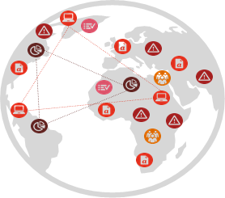
Geopolitical challenges
Overarching theme: Disruptive Supply Chains
However: Technological evolution (blockchain, AI, …) enables shorter supply chains
Health crisis/ocean freight crisis fuelled Capital Spending (contingency emergency plans/remote working technology) and hence decentralized business models. Amplified further by the current pressure on the labor market.
Governments (trying) to increase their stake/impact on Supply Chains (surveillance, intervention, charges,...)
Consumers/multiple stakeholders requiring transparency
Geopolitical tensions provoke commodity price volatility and energy shocks and hence production hiccups
Climate change putting pressure on the business model
Brands are the vehicles of a company’s values and in the sweet spot of the value chain
Business models are anything but stable…Tax models cannot be adapted overnight

Slide 3
Tax and business evolutions
Our experiences
Implications
Tax controversy cases
As value creation (e.g., per region) is linked to senior decision-making in a specific location (delineation), companies need to inventorize, monitor and control the narrative - today and tomorrow (as tax authorities may feel tempted to allocate residual profit)
Legal ownership vs DEMPE/control over risk
Under/over evaluation of central control
(Senior) headcount based profit splits
Asset profile as the centerpiece to the discussion.
Talent management strategies (e.g. which capabilities are required in which locations etc.) rapidly evolve – and it is crucial to monitor how employees’ roles impact the overall corporate structure.
Workforce
Work from anywhere
Hire from anywhere
Ongoing IP creation: impact on system profit allocation
Companies need to evaluate how they fundamentally “create value” today and tomorrow - and secure their value creation (and protection) drivers and adjust to the new value drivers.
Former ‘back office’ as new IP engine/centers of excellence/open innovation
Cost allocation linked to new value drivers (e.g. ESG)

Slide 4
New OECD TP guidance was introduced with a focus on risk
Control over risk involves having the capability to perform decision-making activities in relation to risks and the actual performance thereof (e.g. decision to take on risk/ how to respond to risk).
“If multiple...enterprises…exercise control..., then the risk should be allocated to the… enterprise or group of... enterprises exercising the most control. “
OECD TPG 2020 para 1.98
Legal ownership is not sufficient to retain all intangible returns.
“... The MNE group member(s) making the more significant contributions ...should receive relatively greater remuneration.”
OECD TPG 2020 para 6.55-56
Indicators to determine if a profit split may be considered most appropriate:
unique and valuable contributions,
the shared assumption of economically significant risk and/or
a high level of business integration
“Where one party contributes to the control of an economically significant risk,.. it is appropriate to share in the potential gains and losses associated with the risk in proportion to its contribution of the risk”
OECD TPG para 2.137

Slide 5
Profit allocation in a work from anywhere world
Assets vs People
In the past and present years we notice a tendency by tax authorities to assert residual profit claims based on (senior) headcount (“the ability to control risk” rather than “barriers to entry”)
This (strong) connection made by tax authorities makes it hard for companies to asses tax and talent strategies.
Key decision takers, or economically significant functions (ESF), are pivotal in determining where value is created within a multinational context, increasing the focus on people rather than asset ownership.
Senior decision makers
Profit allocation
Notes:
Profit allocation in a work from anywhere world

Slide 6
A time where control is increasingly getting dispersed - looking at individuals and the aggregate
Dispersion
If decision making is widely dispersed, one location may have more control over risk, but on its own it is unlikely to be sufficient to override the economic analysis.
Limited dispersion
Above-Market Control
What remains is a TP question between two (or three) locations, the HQ and the above market support.
Single location
ESG
Supply Chain
Channel Switch
Tech & R&D
Data
The conclusion is clear: much of the value added in the activity or risk or intangible is attributed to the core location operating all value drivers.

Slide 7
A work from anywhere world - introducing the ESF analysis
Delineation
Pricing
Significance
Capacity
Capability
1
2
3
4
Value chain analysis
Decision making analysis
ESF* analysis
Transfer pricing analysis
*Economically significant functions
The idea that critical mass matters is not new, but it is increasingly important to measure it when assessing the impact of senior people moving, or not being co-located with residual.
Adopting approaches which governments use (e.g. the Herfindahl Hirshman Index or HHI) for other purposes can help decide when to change TP policy when senior people change geography.

Slide 8
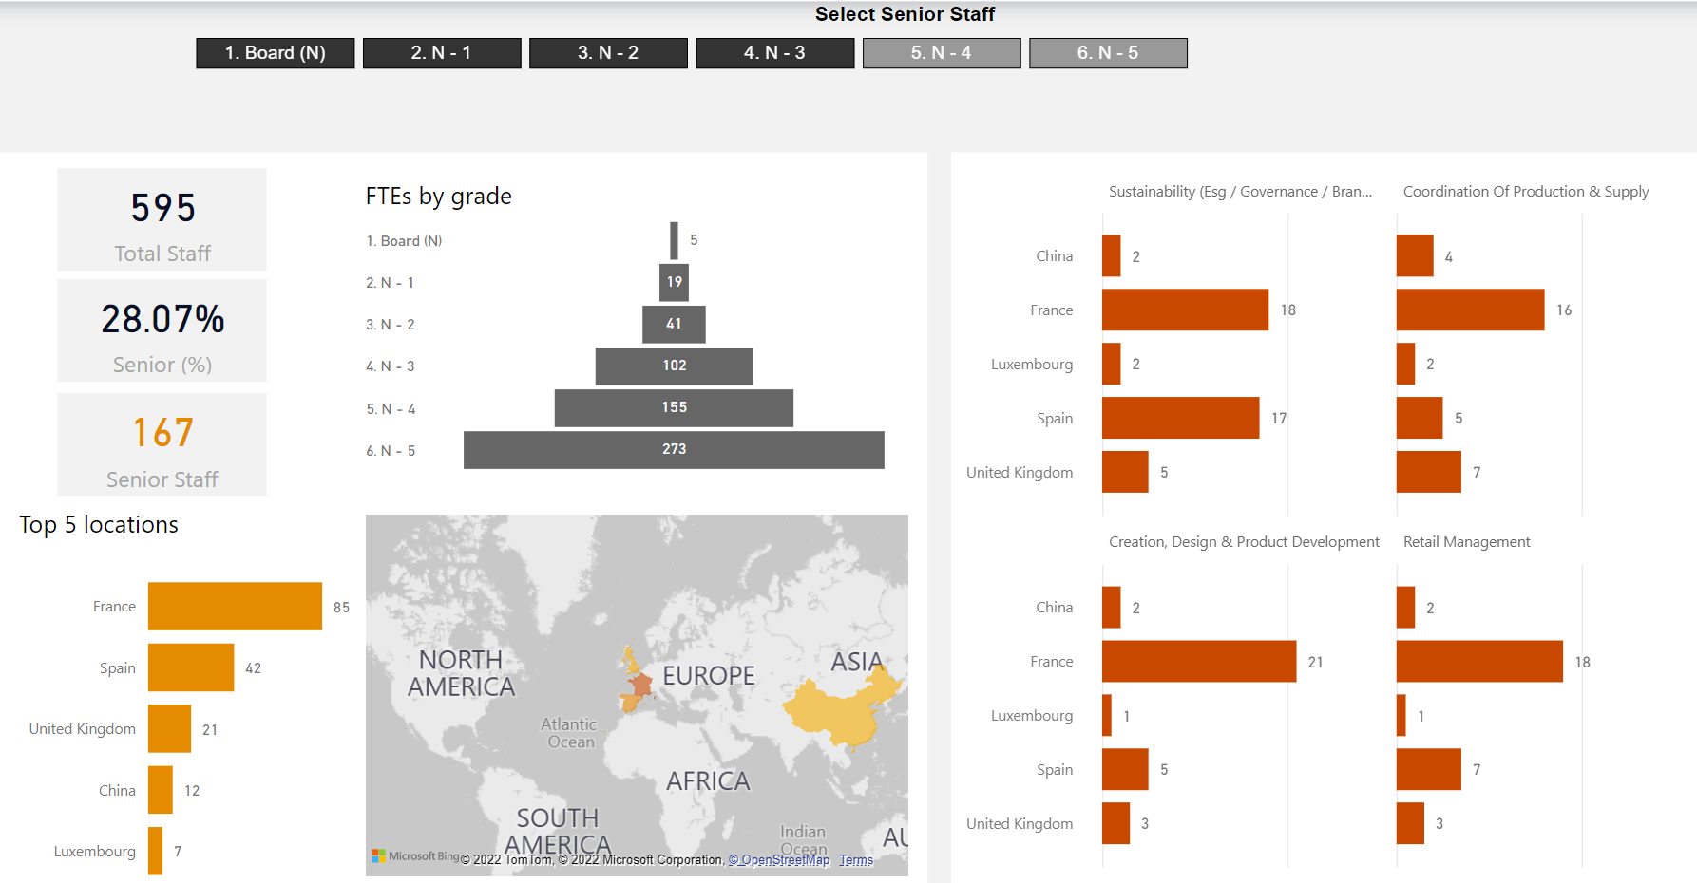
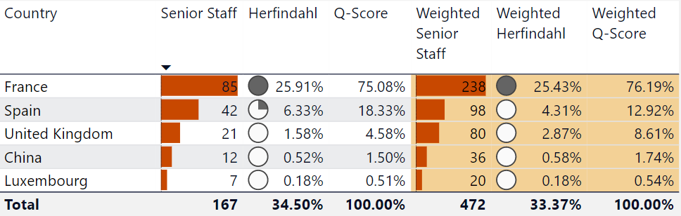
A work from anywhere world - ESF deep dive

Slide 9
Using the data does not ‘beg’ a profit split
Functions are collections of people
Very few functions within a group are entirely vested in a single or even a few individuals. Yet this is often seen as the best practical way to avoid a sea of complexity.
Sometimes it will be sufficient to let the data speak for itself.
‘Accurate Delineation’
Both risk and IP are now evaluated by reference to decision making (within risk controlling functions and those controlling DEMPE).
It remains necessary to identify which functions those are.
Relying on few(er) individuals introduces volatility
Individuals move, resign or retire and are replaced…. Increasingly companies call on people irrespective of geographical location rather than require them to move.
Looking beyond the few to a broader base restores stability.
Transactions (and Contracts)
The question of where risk appropriately lies or which entity is entitled to the economic returns from IP remains a matter for the operational TP design and intercompany contracts.
The main purpose of this analysis is to test and/or support the positions.
A broader view on decision making may be more reliable
Particularly in regional or consensus based organisations, the actual decision making the OECD refers to is vested in a wider team than what a simple organisation chart would suggest.
Taking this into account would probably give more reliable results.
The ‘most’ control
Risk, in particular, is said by the OECD to belong where the ‘most’ control is exercised.
If decision making is spread across a geographically dispersed group, how is this to be measured?

Slide 10
A few thoughts from the trenches…
Aligning profits with purpose
Substantiating the status quo (compliance) What does “value creation” in the group means and how to document? (Rethink) Masterfile?
Solving issues of the past Controversy/MAP cases….(and what about DAC 7?)
The bumpy road to “meaningful transparency” Public CbCR, VAT returns,... risk to give an inaccurate or even erroneous view on economic activity and contribution as they ignore the business model; DAC 6 etc…. Fit for purpose?
Testing and/or supporting the positions Ensure alignment with the tax policy (contractual framework) and manage risk by setting up a robust work from anywhere framework/policy

Slide 11
Thank you
© 2022 PwC. All rights reserved. PwC refers to the PwC network and/or one or more of its member firms, each of which is a separate legal entity. Please see www.pwc.com/structure for further details.

