Slide 1
Automated Tax Guidance in the United States
Joshua Blank, UC-Irvine School of Law
Leigh Osofsky, UNC School of Law

Slide 2


the rise of artificial intelligence

Slide 3
Government attention to artificial intelligence
Feb. 11, 2019: Executive Order on Maintaining American Leadership in AI – directs federal agencies to promote U.S. advancement in AI
2018 Summit on Artificial Intelligence for American Industry – emphasizes use by industry and by government
2016 report from National Science and Technology Council Committee on Technology: “Agencies should . . . share standards and best practices around the use of AI in government operations.”

Slide 4
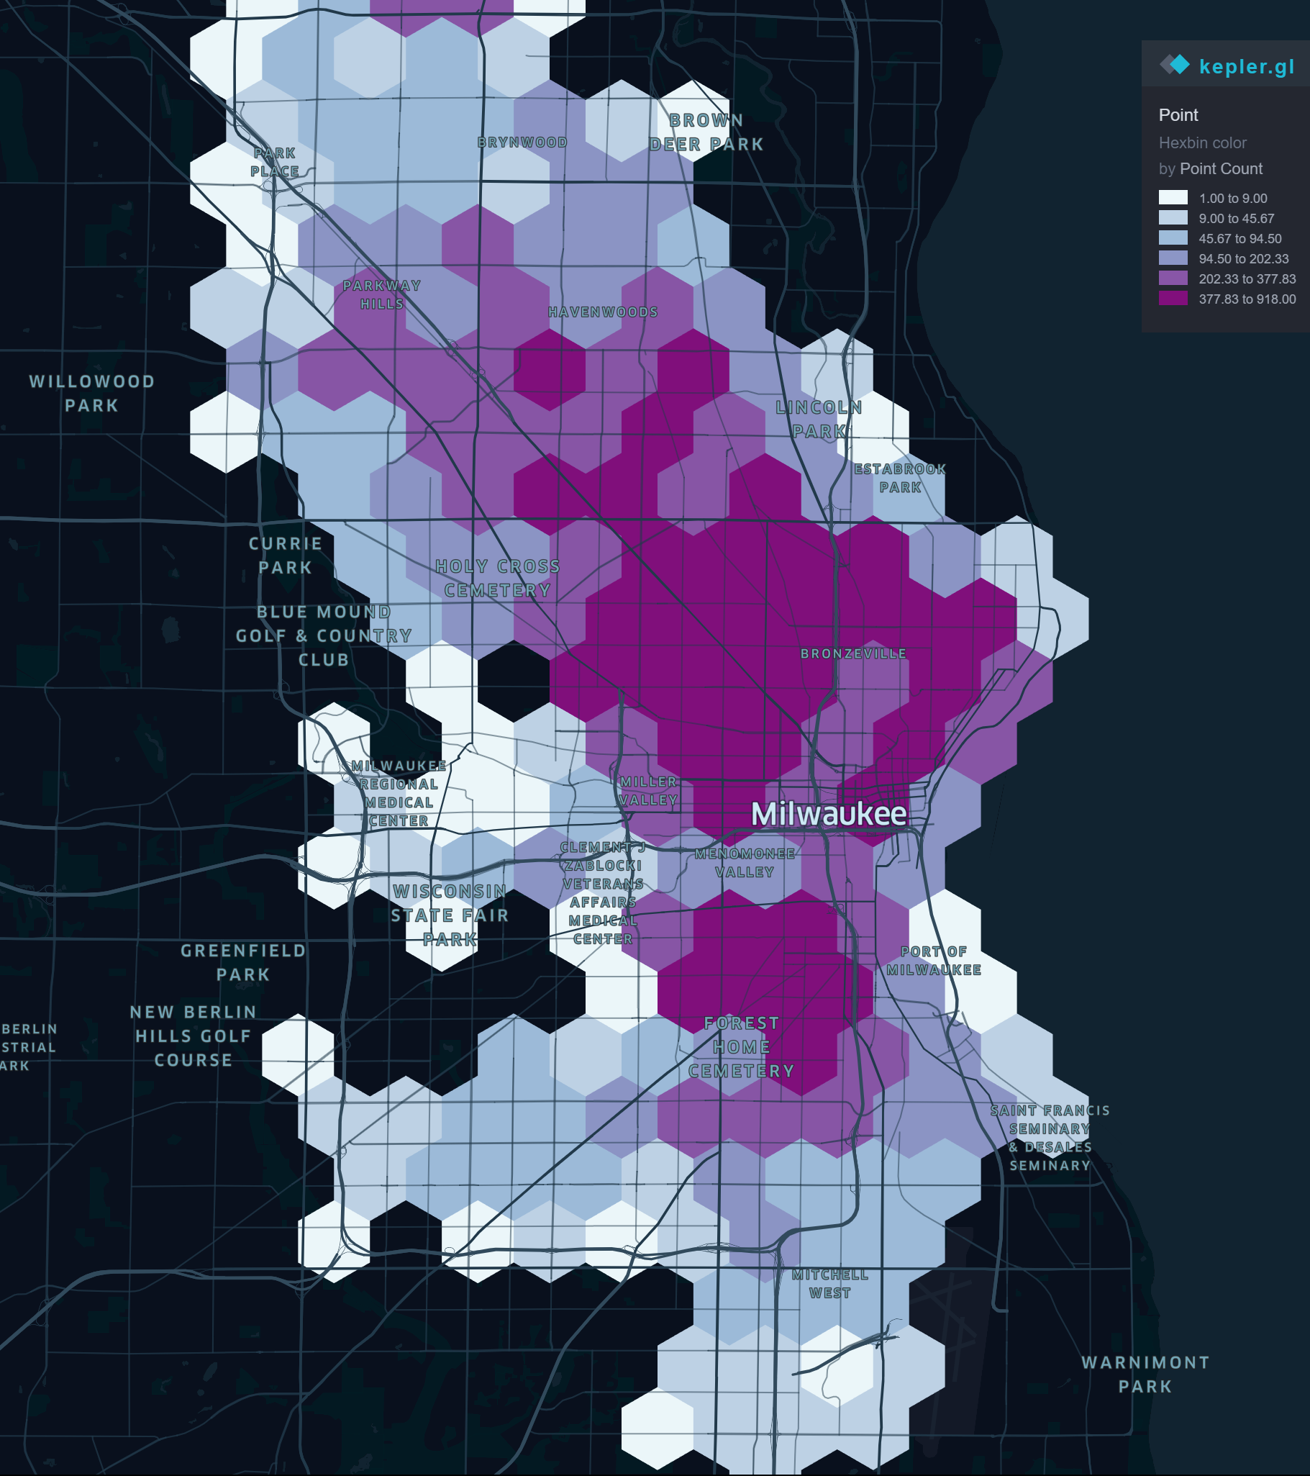
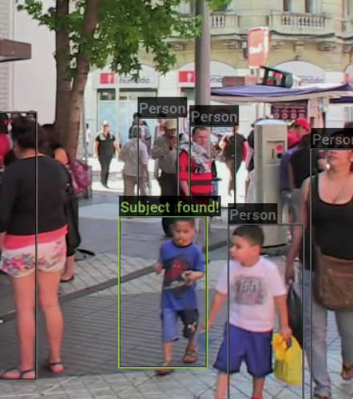

government enforcement through ai

Slide 5
Government service
Taxpayer Bill of Rights, Right to Be Informed
“Taxpayers have the right to know what they need to do to comply with the tax laws. They are entitled to clear explanations of the laws and IRS procedures in all tax forms, instructions, publications, notices, and correspondence. They have the right to be informed of IRS decisions about their tax accounts and to receive clear explanations of the outcomes.”

Slide 6

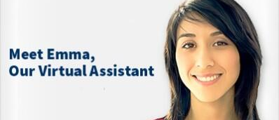

Automated legal guidance

Slide 7
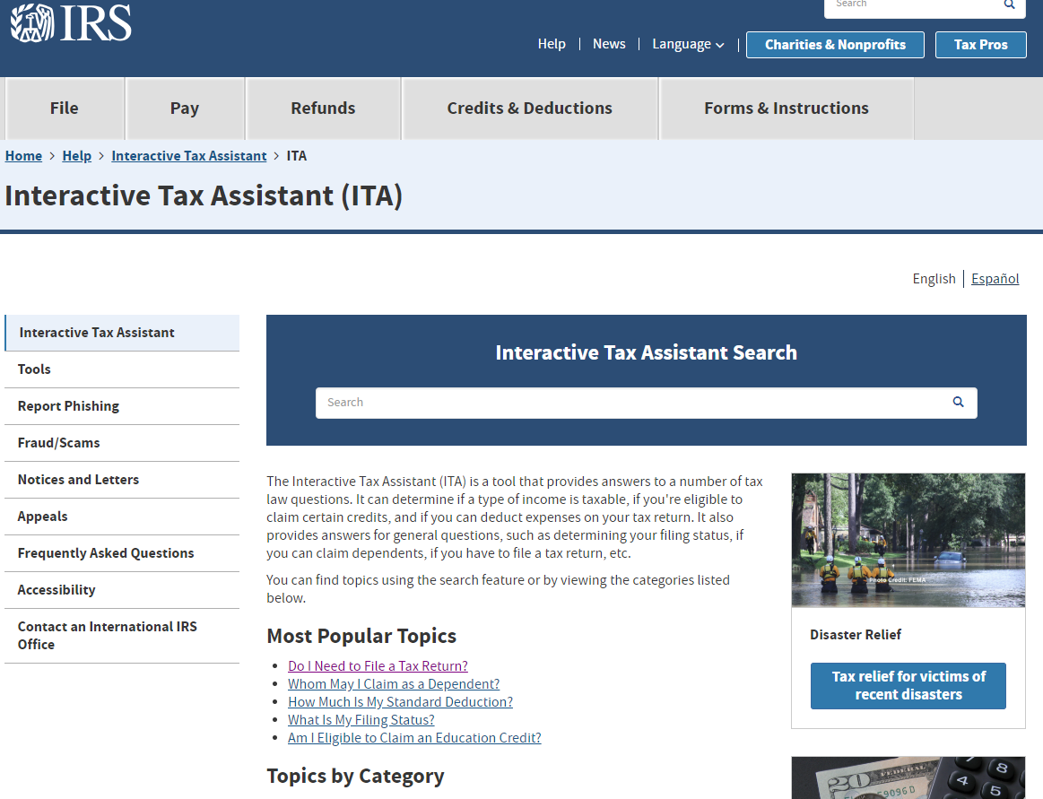
Interactive Tax assistant
(“ita”)

Slide 8
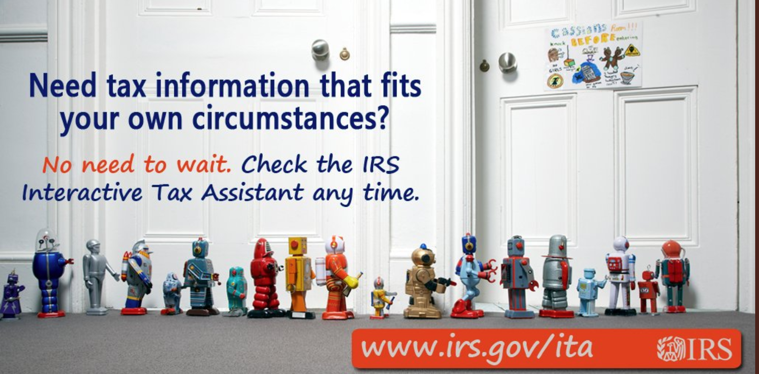

Slide 9
Simplexity
Simplexity = when the government offers clear and simple explanations of the law without highlighting its underlying complexity or reducing this complexity through formal legal changes

Slide 10

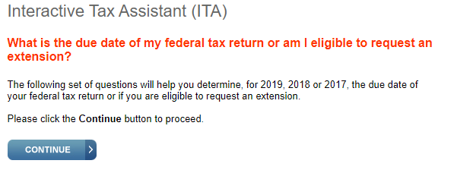
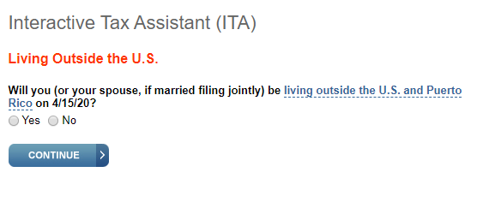
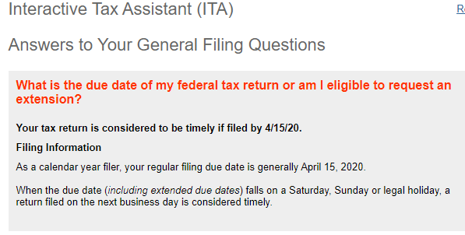
Consistent with the tax law:
filing deadlines

Slide 11

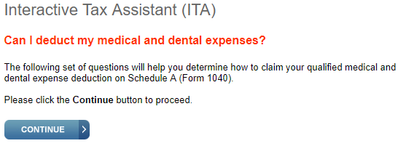
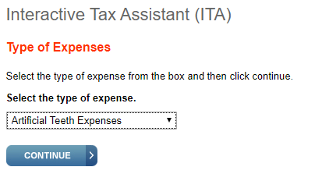
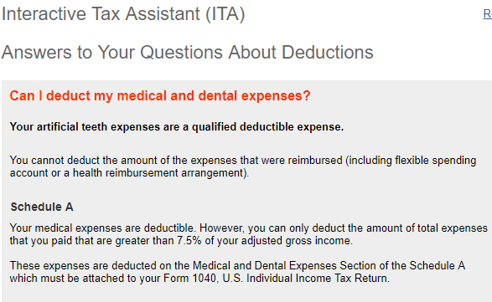
Taxpayer-favorable: artificial teeth

Slide 12

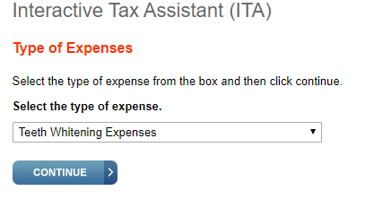
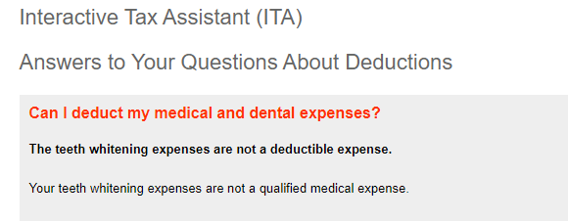
Taxpayer-Adverse: Teeth Whitening

Slide 13
Automated Legal Guidance vs. publications
Personalization
Non-Qualified Statements
Immediate Response

Slide 14
Reaching different user populations
Rules vs. Standards
OR
Simplexity
But for whom?

Slide 15

Administrative process

Slide 16


Slide 17

The future of automated legal guidance?

