Slide 1
Should We Tax AI/Robots?
Professor Orly Mazur

Slide 2
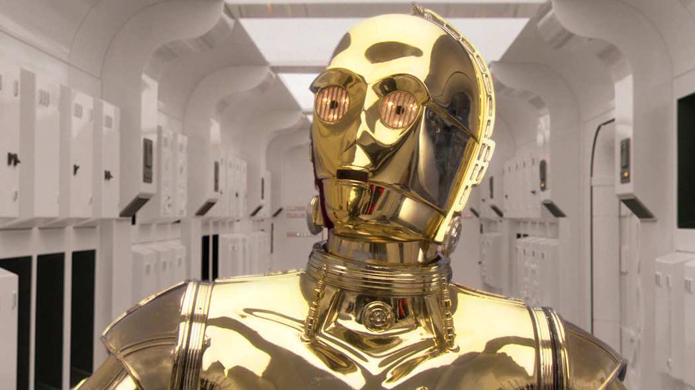
A Robot Tax?!

Slide 3
Roadmap for Today
Implications of Robots in the Workforce
Critique of the Robot Tax
Preparing for the Future: Alternative Solutions

Slide 4
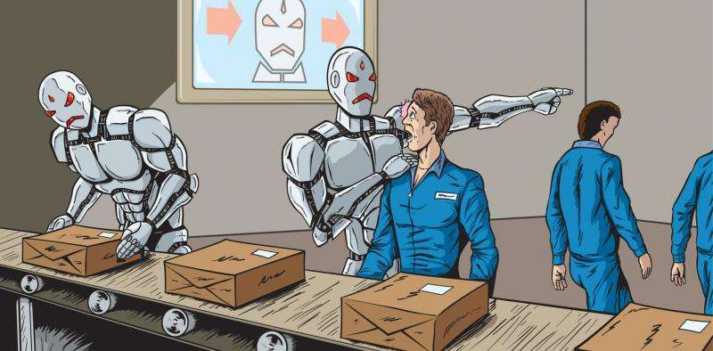
Robots in the Workforce
”Robots are Coming for You and Your Job”
”You Will Lose Your Job to a Robot – and Sooner Than You Think”
”The Robots are Coming – For as Many as 800 Million Jobs!”

Slide 5

International Implications
Labor Market Disruption
Increased Inequality
Declining Government
Revenues

Slide 6
International Implications
Labor Market Disruption
Increased Inequality
Declining Government
Revenues

Slide 7

Declining Government Revenues
Increased Spending
Loss of Tax Revenues
  Social Insurance Taxes
  Individual Income Tax
    Taxed on Gross Basis
    Less Tax Preferences
  Consumption Taxes

Slide 8
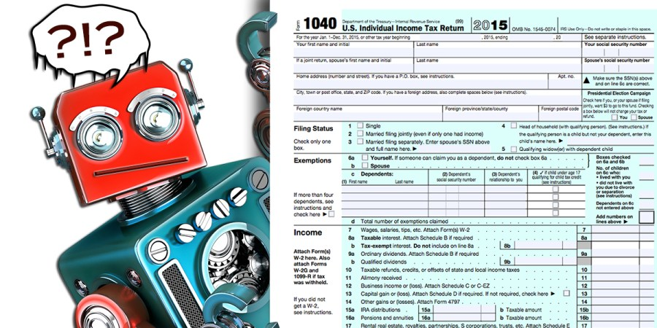
The “Robot Tax” Proposal
Tax the Owners of Robots
Tax Robots as Taxable Persons

Slide 9
Critique of the Robot Tax
Hinders Innovation
Harmful International Tax Competition
Design, Implementation and Administrative Issues
Policy Concerns
Increased Risk of Tax Avoidance Strategies

Slide 10
A Better Solution
Foster Job Creation and Economic Growth
Invest in Human Workers
Strengthen Social Benefit Systems
Modernize Tax Systems

Slide 11
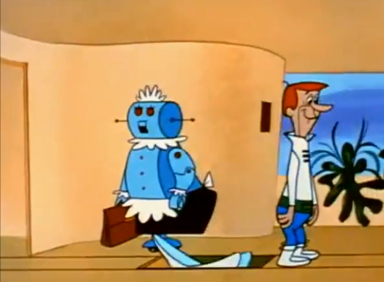
Questions or Comments?
Professor Orly Mazur
SMU Dedman School of Law
Dallas, Texas
omazur@smu.edu

