Slide 1
Global Tax Policy Options for Taxing Billionaires
Belgrade, 6 October 2022
Peter Hongler

Slide 2

Disclaimer
I was asked to talk about the topic – do not expect too progressive solutions!

Slide 3
Some Data (Economics)
Global inequalities (wealth and income) are decreasing (but maybe not a the very very top – 0.01% - data is unclear)
Domestic inequalities are very different (Gini coefficients!)
Wealth composition should impact tax policy decisions
Wealth/income ratios are key from a policy perspective
Conclusion: It seems not possible to develop a clear tax policy valid for all states

Slide 4
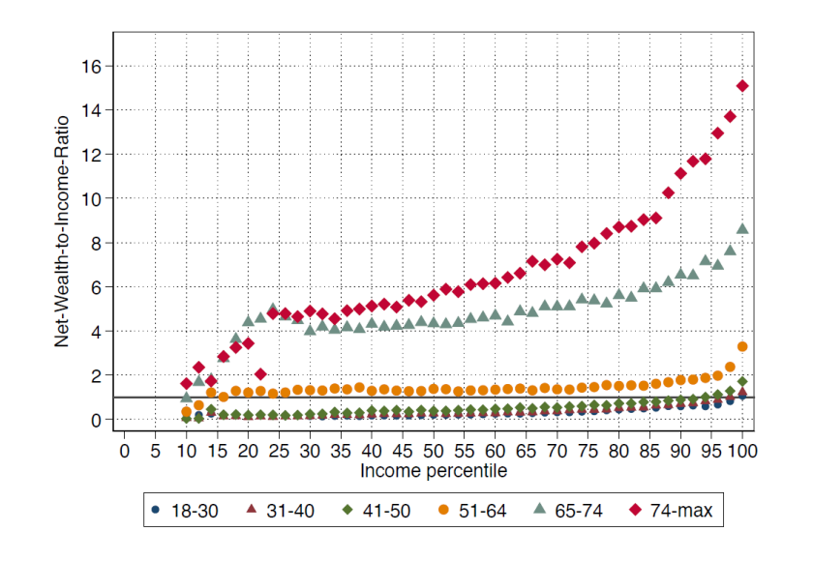
Some Data (Economics)
Source: Martinez 2021

Slide 5
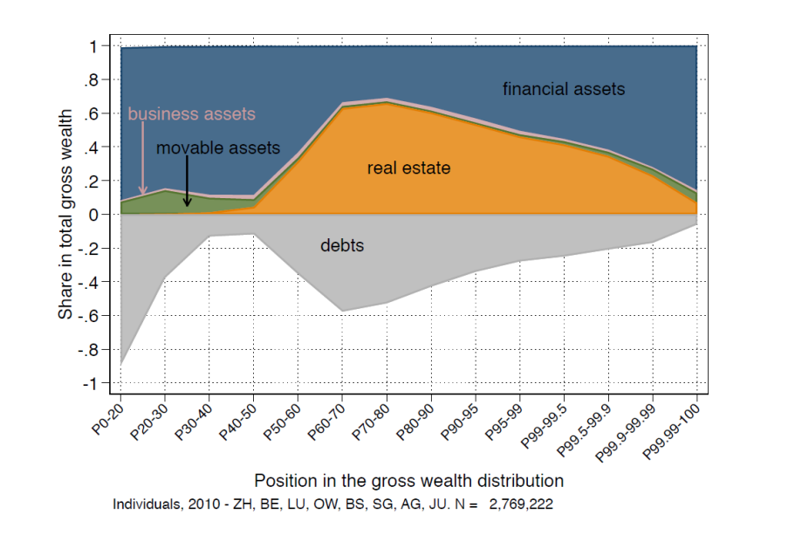
Some Data (Economics)
Source: Martinez 2021

Slide 6

International Tax Policy and Inequalities (Philosophy)
No moral duty to decrease global inequalities but humanitarian duty
What level of inequalities do we want to achieve in a domestic situation:
  Wealth inequalities
  Income inequalities
  Equality of opportunities
Elephant in the room: spending side!

Slide 7
Intermediate conclusion
No moral agreement on what kind of inequalities we want to achieve (philosophy!) and inequalities are so different that a common international tax policy is extremely difficult to develop (economics!). Moreover, taxation might not be the most effective tool to reduce inequalities (elephant!)

Slide 8

Policy options
The following four options exist:
A global minimum tax for billionaires (no normative justification)
A global wealth tax for billionaires (no normative justification)
A global income tax for billionaires (no normative justification)
Challenging harmful tax regimes for billionaires (seems persuasive)

Slide 9

Challenging Harmful Income Tax Regimes
Examples:
Non-Dom status in the UK
Tax exemption upon relocation in Isreal
Lump-sum tax regime in Switzerland
Italy’s substitute tax regime
Main design elements:
Limited personal scope
Often different treatment between foreign and domestic income
Often no comprehensive reporting regarding foreign income and wealth

Slide 10

Challenging Harmful Income Tax Regimes
Similiar features as harmful corporate income tax regimes (no or low effective tax rates, ring-fencing of regimes, transparency, lack of effective exchange of information)
Why challenging harmful tax regimes:
  Most blatant forms of injustice! It is not about comparing 25% vs. 40% income tax rate but maybe 2% vs. 40%.
  It is not about reducing inequalities but about challenging the most extreme forms of injustice (Amartya Sen!)
  Intransparency of these regimes is one of the last jigsaw pieces missing in the framework of global transparency
  Transparency in the resident state protects source taxation (sic!)

Slide 11

Questions

