Slide 1
TAX MORALE, RISK, AND ABUSE
Diego Quiñones Cruz, Esq. LLM, APCLB
Partner, Quiñones Cruz Abogados
Dphil in Law Candidate and Tutor in Law
Harris Manchester College, University of Oxford
February, 2018
IFA Serbia
Belgrade, Serbia

Slide 2
Why is “abuse” a critical element for contemporary tax compliance?
Tax compliance was traditionally assessed as a function of outcomes, both in relation to fulfilling “formal” tax obligations (e.g. filing tax returns at the right time and supplying requested information) and to paying tax as –literally- demanded in legislation.
However, there has been a clear global trend over the past two to three decades to evaluate compliance by asking whether the substantive tax outcome –the tax contribution- matches what applicable law “intended”, regardless of whether it was formally aligned with the letter of the law.

Slide 3
Why is “abuse” a critical element for contemporary tax compliance?
This trend of associating compliance with the primacy of substance over form, which was initiated via judicial precedent in countries like the the US and the UK (purposive approach and Ramsay doctrine), was gradually extended and codified in multiple jurisdictions.
The increasing public visibility and political interest on corporate and HNWI tax affairs seen over the past decade has created a “snowball” effect, whereby these considerations, which were previously reserved for borderline cases, have become central criteria for evaluating compliance. This is particularly clear in the international tax context post-BEPS, but is also applicable domestically.

Slide 4
UK GAAR
“Arrangements are “tax arrangements” if, having regard to all the circumstances, it would be reasonable to conclude that the obtaining of a tax advantage was the main purpose, or one of the main purposes, of the arrangements.
(2)Tax arrangements are “abusive” if they are arrangements the entering into or carrying out of which cannot reasonably be regarded as a reasonable course of action in relation to the relevant tax provisions, having regard to all the circumstances including—
(a)whether the substantive results of the arrangements are consistent with any principles on which those provisions are based (whether express or implied) and the policy objectives of those provisions,
(b)whether the means of achieving those results involves one or more contrived or abnormal steps, and
(c)whether the arrangements are intended to exploit any shortcomings in those provisions.”

Slide 5
GAAR in the EU Anti-Tax Avoidance Directive
“…a Member State shall ignore an arrangement or a series of arrangements which, having been put into place for the main purpose or one of the main purposes of obtaining a tax advantage that defeats the object or purpose of the applicable tax law, are not genuine having regard to all relevant facts and circumstances…
…an arrangement or a series thereof shall be regarded as non-genuine to the extent that they are not put into place for valid commercial reasons which reflect economic reality.”

Slide 6
The Principal Purpose Test (PPT) in the OECD MLI
“…a benefit under the Covered Tax Agreement shall not be granted…if it is reasonable to conclude, having regard to all relevant facts and circumstances, that obtaining that benefit was one of the principal purposes of any arrangement or transaction that resulted directly or indirectly in that benefit, unless it is established that granting that benefit in these circumstances would be in accordance with the object and purpose of the relevant provisions of the Covered Tax Agreement.”

Slide 7
Serbian “Substance over Form” rule
“Tax facts will be interpreted in accordance with its economic substance. Any simulated transaction Will be disregarded and the non-simulated transaction will be taken into account” (trans. Dejan Mrakovic)

Slide 8
What’s problematic about provisions based on “tax abuse”?
The main problem: Pretending to determine whether a taxpayer’s interpretation of tax law is “acceptable” according to a series of allegedly-objective parameters when, in reality, many tax rules are open textured, and therefore are naturally prone to be understood differently by each interpreter.
Additionally, there tends to be a confusion between legal and moral/ethical judgment.

Slide 9
Parameters for Abuse
Anti-abuse provisions, then, rely on a series of parameters, which are complicated to ascertain, and are often confused with subjective moral judgments, rather than factual analyses:
“Objective”
Subjective
Artificiality
Commerciality
Intent to betray the spirit of the law/ good faith
Teleological: What is the main purpose of the transaction?
Is the position aligned with economic “reality” or is it “contrived”?
Is the position “ordinary” and/or “reasonable” for the type of economic activity involved?

Slide 10

Moving from the law to the facts
COMMERCIALITY
COMMERCIAL AWARENESS
Company-specific
Sector-specific
Main purpose analysis
WHAT WAS THE TAXPAYER THINKING?
“Good faith” intention analysis
Do corporations have a “mind”?

Slide 11
Analysing Corporate “Tax Culture”
How are positions determined and overseen? Tax governance
Tax positions chosen (Tactics)
Tax Behaviour
Tax Contribution (outcome)
Corporate Tax Culture
Relationship with the authorities
Understanding of taxes
Tax Morale
Perception of authorities
Tax risk appetite

Slide 12

Factors associated with Tax Culture (Determinants)
The corporation is influenced by key individuals within it, but at the same time, it influences them (loop)
The Corporation
Both the corporation and its key individuals are influenced by the context where they operate and the structure of the organisation
MACRO/CONTEXTUAL FACTORS
ORGANISATIONAL FACTORS

Slide 13
Tax Culture “On the Field”
The following slides analyse factors closely associated to corporate tax risk, as seen in empirical research conducted in 2016-2017 with large corporations (multiple economic sectors, all MNCs, different ownership structures) and corporate tax directors in the UK and in Colombia.
Comparative research: Emerging market vs. a developed economy, fairly similar corporate income tax systems (with the exception of the UK’s semi-territorial system), but different compliance paradigms (UK co-operative compliance; COL traditional command and control compliance).

Slide 14
Individual Factors: Tax executive personal objectives in relation to work
Risk Aversion and Compliance are tied with key individuals’ professional objectives in relation to tax
COL
Risk mitigators: ‘My main objective is that what happens today does not turn into a living hell tomorrow and that whatever bad happened today will be managed. We know that there’s risk so we try to normalize and prevent future risk by control.’ (P24COL)
Tax Minimisers: ‘…I feel very satisfied when I know that my tax strategy and planning were efficient…it’s about saving money.’ (P11COL)
Multi-taskers: ‘We cannot afford the luxury of non-compliance, so we try to have an adequate tax planning, trying to support positions which do not place the corporation under risk …We do try to optimise, but we are framing that within the context of what the taxation of a corporation such as this one “should be”.’ (P14 COL)
UK
No surprises: ‘My key objective is giving some reliable guidance. We are a publicly listed company and the analysts and shareholders want to know the numbers, so I want to avoid surprises, make sure that everything is robust and can be supported, no nasty surprises and audits.’ (P20UK)
Compliance: ‘My main objective is to ensure that we tax effect every transaction in an appropriate way, that we don’t miss anything, that we are accurate in our compliance and report completely and accurately to external stakeholders...’ (P4UK)

Slide 15
Organisational factors: How are tax executives remunerated/evaluated
In terms of agency, tax executive objectives are linked to the incentives their companies give them via remuneration and/or evaluation: Are they assessed in relation to tax performance indicators and, if so, are these compliance-inducing or risk reducing, or do they encourage risk-taking?
COL
Persistent use of tax-related KPIs (albeit, slight reduction)
Tax KPIs are often attached to achieving higher tax savings, not reducing risk or ensuring compliance
UK
Clear progression away from tax-related KPIs
Where these KPIs do exist, there is a shift towards encouraging accuracy in tax outcome predictions and reducing risk.

Slide 16
Organisational Factors: When is tax considered within the business decision-making cycle
OTHER BUSINESS FACTORS
TAX
BEFORE
ALONGSIDE
AFTER
Business Decision
Fundamental for PPT clauses and GAARs. Where tax predates business decisions, it is more likely that tax will be considered to be the main purpose behind the position. Where tax is considered before or after other business factors there is an increased risk of accidental non-compliance (the tax team scrambles to “fix the mess”, or of intentional non-compliance (the tax team instructs other teams to pursue a tax-driven scheme.

Slide 17
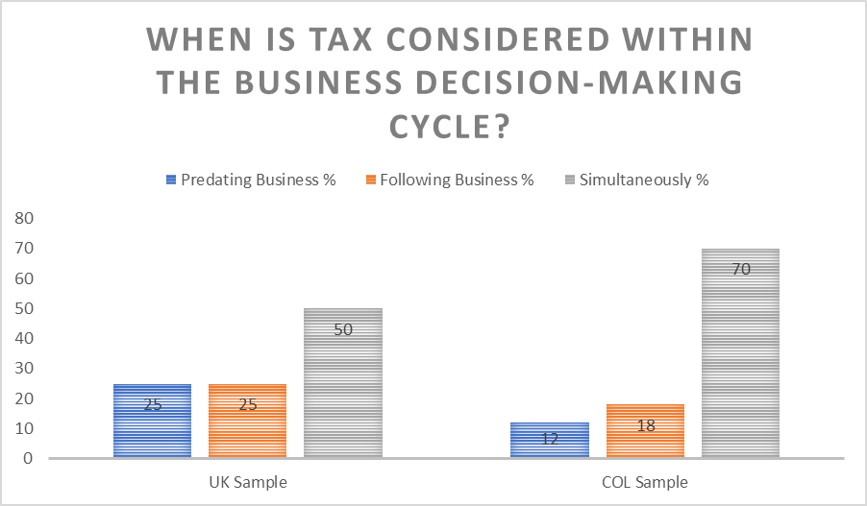
Both samples show convergence towards considering tax alongside other business variables, something which should reduce tax risk. However, there is still some willingness, particularly in the UK, to allow tax to be the driver (be the main purpose of) business decisions, specially in relation to international relocations, transfer pricing, and corporate reorganisations (which is precisely what the MLI is concerned about).

Slide 18
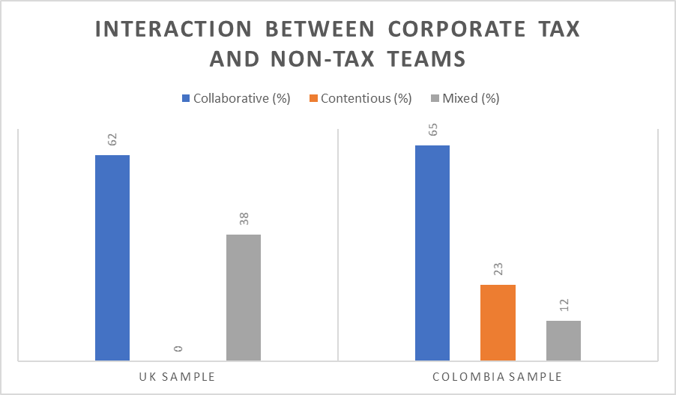
Tax Risk and the interaction between in house tax teams and non-tax teams
Tax risk is associated to the quality of the interaction between tax and non-tax teams within corporations:
Close interactions:
More commercially-based TPs
Lower accidental non-compliance
Detached/Contentious interaction:
Higher accidental-non compliance
Increased artificiality
Reduced commerciality
Is the tax team seen as a partner or as an obstacle?
The deference awarded to the tax team depends on its hierarchy within the organisation and the “tone from the top” regarding tax.
Is the tax team as working for the administration?
How does the tax team see itself? Cost centre vs. Profit centre/ internal control?

Slide 19
Contextual Factors: Public visibility of Corporate Tax affairs and Reputational Risk
Level of public visibility of Corporate Tax issues
Reputational Risk
Corporate Tax Culture
Higher for B2C industries and Public proc. Industries
Higher for listed corporations
Generally higher for MNCs
Board Involvement
Political Pressure
Conservative tax approach
Changes in tax rules
Changes in the tax administration’s approach
Cosmetic compliance
Resistance/Detachment

Slide 20
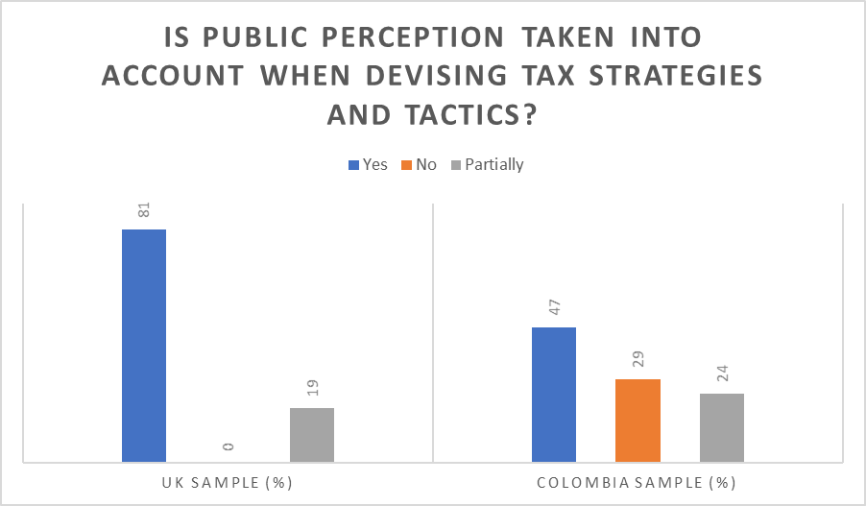
UK
Elevated public visibility (media-fueled)
Increased reputational risk awareness among corporate boards and TD’s leads to risk aversion and conservative approaches or cosmetic compliance.
Proliferation of anti-abuse rules (inc.penalties for enablers)
“Bounded-hands” effect on the administration
COL
Low public visibility (low media interest)
However, increased reputational risk awareness (associated with MNC trends) among TDs, not so among boards.
Proliferation of anti-abuse rules (but not on enablers)
No “Bounded-hands” effect on the administration –but this reduces accountability-

Slide 21
Perception of the Authorities
Compliance-mindedness and risk appetite is heavily influenced by the perception of the authorities the taxpayer has.
In terms of deterrence, taxpayers tend to assess the probability of being “caught” if they don’t comply, the probability they are penalised if detected, and the magnitude of penalties.
Additionally, psychologically, taxpayers’ compliance is associated to whether they perceive the authorities as trustworthy.
Detection
Public interest motivation
POWER
TRUST
Attitude
Enforcement
Reliability

Slide 22
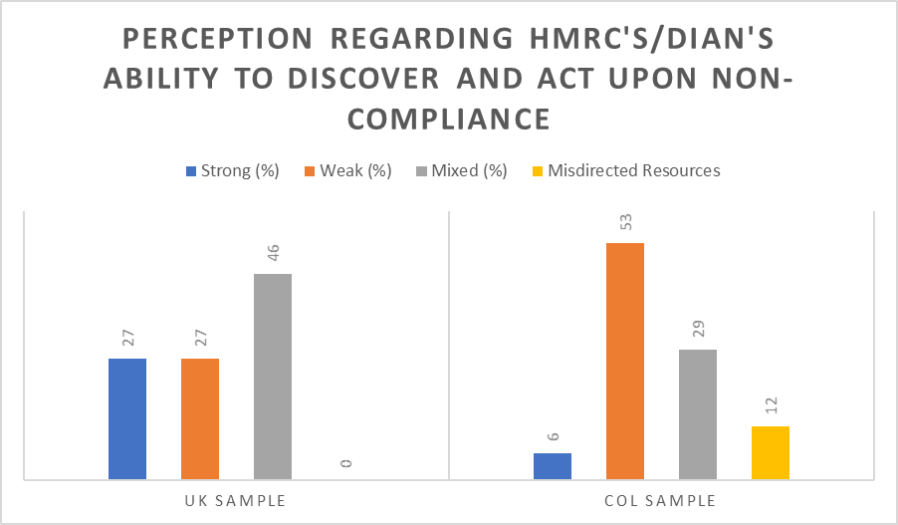
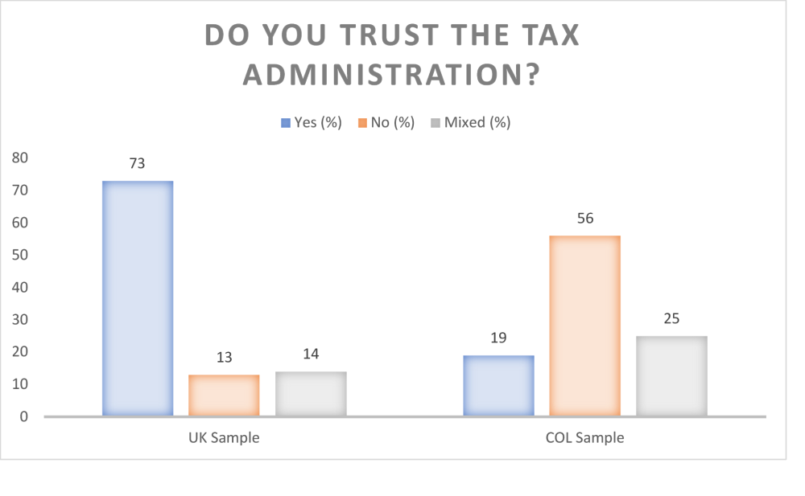
POWER
TRUST

Slide 23
Approaches to Tax Risk
RIGID
TAX-SPECIFIC
How is risk assessed?
FLEXIBLE
BALANCED
GENERIC
P of administrative challenge
P of overturning administration judicially
How is risk measured?
P of overcoming administrative challenge
P of causing reputational damage if leaked (authorities inc.)
Who evaluates risk?
TAX
LEGAL
EXTERNAL ADVISORS
FINANCE/ACC
THE BOARD

Slide 24
Risk and Acceptability of Tax Positions
LEGALITY
COMMERCIALITY
RISKINESS
Textual/Literal approach
Purposive approach –and whose intent is analysed?-
Industry sector benchmarking
Admin/judicial commercial awareness
ARTIFICIALITY
ETHICS/MORALITY
Sustainability
Effect on financial accounts

Slide 25
CASE ANALYSIS
In the context of an economic recession, as part of a legislative package to boost economic productivity, parliament enacts a new tax provision which stipulates that “taxpayers who acquire fixed, productive, real assets, can claim in the year of acquisition a tax credit for 40% of the asset’s acquisition value, in addition to depreciation” There are no other conditions.
A corporation dedicated to manufacturing computer hardware buys a fleet of Mercedes Benz sedans to transport its directive personnel, and claims the tax credit against its CIT liability.
A law firm purchases 20 high-end network servers and subsequently sells them, a week later. The law firm claims the tax credit.

Slide 26
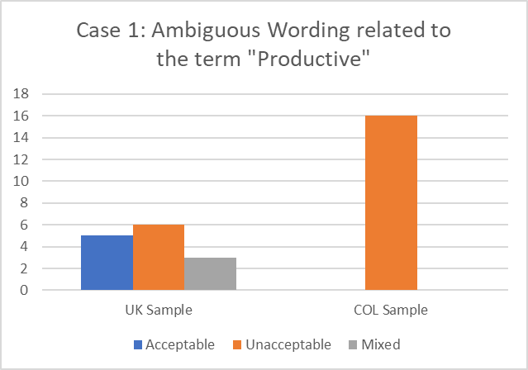
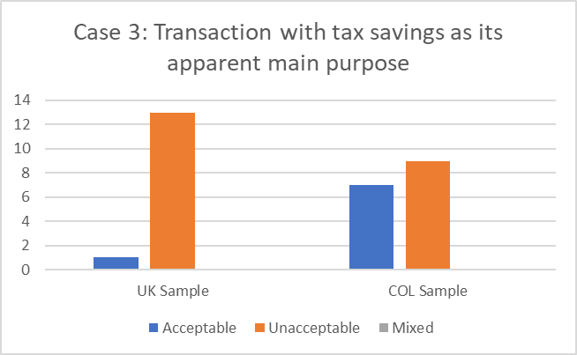

Slide 27
Thank you!

